Slide 1
Amazon EC2
Amazon Elastic Compute Cloud, EC2 is a web service from Amazon that provides re-sizable compute services in the cloud.

Slide 2

Amazon EC2
Amazon Elastic Compute Cloud, EC2 is a web service from Amazon that provides re-sizable compute services in the cloud.
How are they re-sizable?
They are re-sizable because you can quickly scale up or scale down the number of server instances you are using if your computing requirements change.

Slide 3
AMAZON EC2 PROVIDES:
Virtual computing environments, known as instances
Preconfigured templates for your instances, known as Amazon Machine Images (AMIs), that package the bits you need for your server (including the operating system and additional software)
Various configurations of CPU, memory, storage, and networking capacity for your instances, known as instance types
Secure login information for your instances using key pairs (AWS stores the public key, and you store the private key in a secure place)
A firewall that enables you to specify the protocols, ports, and source IP ranges that can reach your instances using security groups

Slide 4
AMAZON EC2 PROVIDES
Elastic Web-Scale Computing
You can increase or decrease capacity within minutes and commission one to thousands of instances simultaneously.
Completely Controlled
AWS EC2 give you complete control including root access to each instance and can stop and start instances without losing data and use web service APIs.
Flexible Cloud Hosting Services
You can choose from multiple instance types & operating systems as well as instances with varying memory, CPU, and storage configurations.

Slide 5
AMAZON EC2 PROVIDES
Elasticity
The “Elastic” nature of the service allows developers to instantly scale to meet spikes in traffic or demand. When computing requirements unexpectedly change (up or down), Amazon EC2 can instantly respond, meaning that developers can control how many resources are in use at any given point in time.
Instances
An instance is a virtual server in the cloud. Its configuration at launch is a copy of the AMI that you specified when you launched the instance.

Slide 6
What is an Instance?
An instance is a virtual server for running applications on Amazon’s EC2.
It can also be understood like a part of a larger computer, a part which has its own Hard drive, network connection, OS etc.
You can have multiple computers on a single physical machine, and all these machines are called Instances.
An Amazon EC2 instance is a virtual server in Amazon's Elastic Compute Cloud (EC2) scalable compute platform for running applications on the Amazon Web Services (AWS) cloud.
Amazon EC2 provides various types of instances of different sizes, with each comprising different configurations of central processing unit (CPU), memory, storage and networking resources to suit user needs and workloads.

Slide 7
Amazon Machine Images (AMI)
An Amazon Machine Image (AMI) is an image that provides the software that is required to set up and boot an Amazon EC2 instance.
Each AMI also contains a block device mapping that specifies the block devices to attach to the instances that you launch.
You must specify an AMI when you launch an instance.
The AMI must be compatible with the instance type that you chose for your instance.
You can use an AMI provided by AWS, a public AMI, an AMI that someone else shared with you, or an AMI that you purchased from the AWS Marketplace.

Slide 8
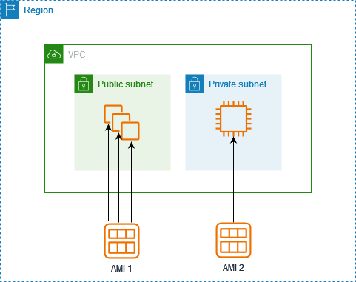
Amazon Machine Images (AMI)
An AMI is specific to the following:
Region
Operating system
Processor architecture
Root device type
Virtualization type
You can launch multiple instances from a single AMI when you require multiple instances with the same configuration.
You can use different AMIs to launch instances when you require instances with different configurations, as shown in the following diagram.

Slide 9
Amazon EC2 Instance types
Amazon EC2 provides a wide selection of instance types optimized to fit different use cases.
Instance types comprise varying combinations of CPU, memory, storage, and networking capacity and give you the flexibility to choose the appropriate mix of resources for your applications.
Each instance type includes one or more instance sizes, allowing you to scale your resources to the requirements of your target workload.

Slide 10
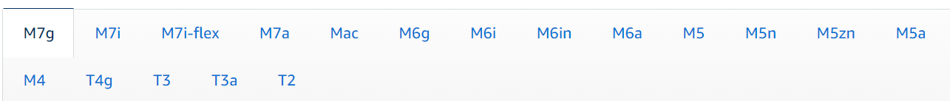
General Purpose
General purpose instances provide a balance of compute, memory and networking resources, and can be used for a variety of diverse workloads.
These instances are ideal for applications that use these resources in equal proportions such as web servers and code repositories.

Slide 11
Compute Optimized
Compute Optimized instances are ideal for compute bound applications that benefit from high performance processors.
Instances belonging to this category are well suited for batch processing workloads, media transcoding, high performance web servers, high performance computing (HPC), scientific modeling, dedicated gaming servers and ad server engines, machine learning inference and other compute intensive applications.

Slide 12
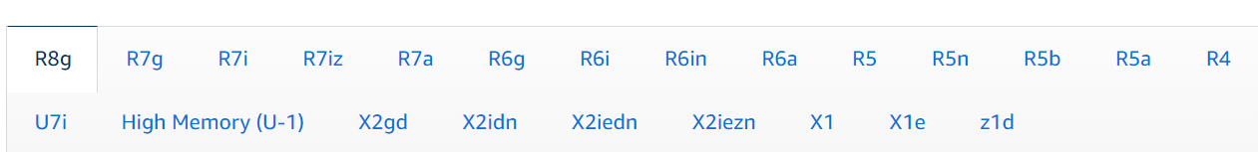
Memory Optimized
Memory optimized instances are designed to deliver fast performance for workloads that process large data sets in memory.

Slide 13
Accelerated Computing
Accelerated computing instances use hardware accelerators, or co-processors, to perform functions, such as floating point number calculations, graphics processing, or data pattern matching, more efficiently than is possible in software running on CPUs.

Slide 14
Storage Optimized
Storage optimized instances are designed for workloads that require high, sequential read and write access to very large data sets on local storage.
They are optimized to deliver tens of thousands of low-latency, random I/O operations per second (IOPS) to applications.

Slide 15

HPC Optimized
High performance computing (HPC) instances are purpose built to offer the best price performance for running HPC workloads at scale on AWS.
HPC instances are ideal for applications that benefit from high-performance processors such as large, complex simulations and deep learning workloads.

Slide 16
Amazon EC2 Pricing
Amazon EC2 is free to try.
There are multiple ways to pay for EC2 instances:
On-Demand
Savings Plans
Reserved Instances
Amazon EC2 Spot Instances.

Slide 17
Purchase models
On-Demand
Savings Plans
Amazon EC2 Spot Instances

Slide 18
On-Demand
On-Demand Instances let you pay for compute capacity by the hour or second with no long-term commitments. This frees you from the costs and complexities of planning, purchasing, and maintaining hardware and transforms what are commonly large fixed costs into much smaller variable costs.
On-Demand Instances are recommended for:
Users that prefer the low cost and flexibility of EC2 without any upfront payment or long-term commitment
Applications with short-term, spiky, or unpredictable workloads that cannot be interrupted
Applications being developed or tested on EC2 for the first time

Slide 19
Savings Plans
Savings Plans is a flexible pricing model that can help you reduce your bill by up to 72% compared to On-Demand prices, in exchange for a commitment to a consistent amount of usage (measured in $/hour) for a 1- or 3-year term.
AWS offers three types of Savings Plans: Compute Savings Plans, EC2 Instance Savings Plans, and Amazon SageMaker Savings Plans. Compute Savings Plans apply to usage across Amazon EC2, AWS Lambda, and AWS Fargate.
Savings Plans are recommended for:
Committed and steady-state usage
Users looking to take advantage of the latest compute offerings while continuing to save money

Slide 20
Amazon EC2 Spot Instances
Amazon EC2 Spot Instances let you take advantage of unused EC2 capacity in the AWS cloud and are available at a discount of up to 90% compared to On-Demand prices.
Spot Instances are recommended for:
Fault tolerant or stateless workloads
Applications that can run on heterogeneous hardware
Applications that have flexible start and end times

Slide 21
Reserved or dedicated capacity
On-Demand Capacity Reservations
Amazon EC2 Capacity Blocks for ML
Dedicated Hosts

Slide 22
On-Demand Capacity Reservations
On-Demand Capacity Reservations enable you to reserve compute capacity for your EC2 instances in a specific Availability Zone for any duration. Capacity reservations mitigate against the risk of being unable to get On-Demand capacity in case of capacity constraints and ensure that you always have access to EC2 capacity when you need it, for as long as you need it.
On-Demand Capacity Reservations are recommended for:
Business-critical events or workloads that require capacity assurance
Workloads that need to meet regulatory requirements for high availability
Disaster recovery

Slide 23
Amazon EC2 Capacity Blocks for ML
With Amazon EC2 Capacity Blocks for ML, you can easily reserve GPU instances for a future date to run your machine learning (ML) workloads. You pay only for the amount of compute time that you need, with no long-term commitment. EC2 Capacity Blocks can be used to reserve Amazon EC2 P5 or P4d instances.
EC2 Capacity Blocks are recommended for:
Training and fine-tuning ML models
Running experiments and building prototypes
Planning for future surges in demand for ML applications

Slide 24
Dedicated Hosts
A Dedicated Host is a physical EC2 server fully dedicated for your use. Dedicated Hosts can help you reduce costs by allowing you to use your existing server-bound software licenses, including Windows Server, SQL Server, and SUSE Linux Enterprise Server (subject to your license terms). Dedicated Hosts can be purchased On-Demand (hourly) or can be purchased as part of Savings Plans.
Dedicated Hosts are recommended for:
Users looking to save money on licensing costs
Workloads that need to run on dedicated physical servers
Users looking to offload host maintenance onto AWS, while controlling their maintenance event schedules to suit their business’s operational needs

Slide 25
Amazon Elastic Block Store

Slide 26
Amazon Elastic Block Store
Amazon Elastic Block Store (Amazon EBS) provides scalable, high-performance block storage resources that can be used with Amazon Elastic Compute Cloud (Amazon EC2) instances.

Slide 27
Amazon Elastic Block Store
With Amazon Elastic Block Store, you can create and manage the following block storage resources:
Amazon EBS volumes — These are storage volumes that you attach to Amazon EC2 instances. After you attach a volume to an instance, you can use it in the same way you would use a local hard drive attached to a computer, for example to store files or to install applications.
Amazon EBS snapshots — These are point-in-time backups of Amazon EBS volumes that persist independently from the volume itself. You can create snapshots to back up the data on your Amazon EBS volumes. You can then restore new volumes from those snapshots at any time.

Slide 28
Features of Amazon EBS
Multiple volume types — Amazon EBS provides multiple volume types that allow you to optimize storage performance and cost for a broad range of applications. Volume types are divided into two major categories: SSD-backed storage for transactional workloads, and HDD-backed storage for throughput intensive workloads.
Scalability — You can create Amazon EBS volumes with capacity and performance specifications that meet your needs. As your needs changes, you can use Elastic Volumes operations to dynamically increase capacity or tune performance, with no downtime.

Slide 29
Features of Amazon EBS
Backup and recovery — Use Amazon EBS snapshots to back up the data stored on your volumes. You can then use those snapshots to instantly restore volumes or to migrate data across AWS accounts, AWS Regions, or Availability Zones.
Data protection — Use Amazon EBS encryption to encrypt your Amazon EBS volumes and Amazon EBS snapshots. Encryption operations occur on the servers that host Amazon EC2 instances, ensuring the security of both data-at-rest and data-in-transit between an instance and its attached volume and subsequent snapshots.

Slide 30
Features of Amazon EBS
Data availability and durability — io2 Block Express volumes provide 99.999% durability with an annual failure rate of 0.001%. Other volume types provide 99.8% to 99.9% durability with an annual failure rate of 0.1% to 0.2%. Additionally, volume data is automatically replicated across multiple servers in an Availability Zone to prevent the loss of data from the failure of any single component.
Data archiving — EBS Snapshots Archive provides a low-cost storage tier to archive full, point-in-time copies of EBS Snapshots that you must retain for 90 days or more for regulatory and compliance reasons, or for future project releases.

Slide 31
EBS Volume Types
Amazon EBS provides multiple volume types that allow you to optimize storage performance and cost for a broad range of applications.
These volume types are divided into two major categories:
SSD-backed storage for transactional workloads, such as databases, virtual desktops and boot volumes,
HDD-backed storage for throughput intensive workloads, such as MapReduce and log processing.

Slide 32
EBS Volume Types
SSD-based volumes include the highest performance EBS volumes (io2 Block Express and io1) for your most demanding transactional applications including SAP HANA, Microsoft SQL Server and IBM DB2, and General Purpose SSD volumes (gp3 and gp2) that balance price and performance for transactional applications, including virtual desktops, test and development environments, and interactive gaming applications.
HDD-based volumes include Throughput Optimized HDD (st1) for frequently accessed, throughput intensive workloads and the lowest cost Cold HDD (sc1) for less frequently accessed data.

Slide 33
Amazon EC2 Auto Scaling
Add or remove compute capacity to meet changing demand

Slide 34
Amazon EC2 Auto Scaling
Amazon EC2 Auto Scaling helps you maintain application availability and lets you automatically add or remove EC2 instances using scaling policies that you define.
Dynamic or predictive scaling policies let you add or remove EC2 instance capacity to service established or real-time demand patterns.
The fleet management features of Amazon EC2 Auto Scaling help maintain the health and availability of your fleet.

Slide 35
Amazon EC2 Auto Scaling
Amazon EC2 Auto Scaling helps you ensure that you have the correct number of Amazon EC2 instances available to handle the load for your application.
You create collections of EC2 instances, called Auto Scaling groups.
You can specify the minimum number of instances in each Auto Scaling group, and Amazon EC2 Auto Scaling ensures that your group never goes below this size.
You can specify the maximum number of instances in each Auto Scaling group, and Amazon EC2 Auto Scaling ensures that your group never goes above this size.
If you specify the desired capacity, either when you create the group or at any time thereafter, Amazon EC2 Auto Scaling ensures that your group has this many instances.
If you specify scaling policies, then Amazon EC2 Auto Scaling can launch or terminate instances as demand on your application increases or decreases.

Slide 36
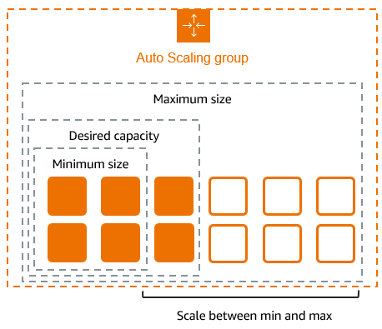
Amazon EC2 Auto Scaling
For example, the following Auto Scaling group has a minimum size of four instances, a desired capacity of six instances, and a maximum size of twelve instances.
The scaling policies that you define adjust the number of instances, within your minimum and maximum number of instances, based on the criteria that you specify.

Slide 37
Benefits of Autoscaling
Improve fault tolerance : Improve fault tolerance through automatic detection and replacement of unhealthy instances.
Increase availability : Increase availability with predictive or dynamic scaling policies with the right amount of compute capacity.
Optimize workload performance and cost : Optimize workload performance and cost by combining purchase options and instance types.
Reduce complexity : Reduce the complexity of configuration changes and application deployments with instance refresh.

Slide 38
Features of Amazon EC2 Auto Scaling
With Amazon EC2 Auto Scaling, your EC2 instances are organized into Auto Scaling groups so that they can be treated as a logical unit for the purposes of scaling and management.
Auto Scaling groups use launch templates (or launch configurations) as configuration templates for their EC2 instances.

Slide 39
Features of Amazon EC2 Auto Scaling
Monitoring the health of running instances : Amazon EC2 Auto Scaling automatically monitors the health and availability of your instances using EC2 health checks and replaces terminated or impaired instances to maintain your desired capacity.
Custom health checks : In addition to the built-in health checks, you can define custom health checks that are specific to your application to verify that it's responding as expected. If an instance fails your custom health check, it's automatically replaced to maintain your desired capacity.

Slide 40
Features of Amazon EC2 Auto Scaling
Balancing capacity across Availability Zones : You can specify multiple Availability Zones for your Auto Scaling group. This provides high availability and resiliency by protecting your applications from failures in a single location.
Multiple instance types and purchase options : Within a single Auto Scaling group, you can launch multiple instance types and purchase options (Spot and On-Demand Instances), allowing you to optimize costs through Spot Instance usage. You can also take advantage of Reserved Instance and Savings Plan discounts by using them in conjunction with On-Demand Instances in the group.

Slide 41
Features of Amazon EC2 Auto Scaling
Automated replacement of Spot Instances : If your group includes Spot Instances, Amazon EC2 Auto Scaling can automatically request replacement Spot capacity if your Spot Instances are interrupted. Through Capacity Rebalancing, Amazon EC2 Auto Scaling can also monitor and proactively replace your Spot Instances that are at an elevated risk of interruption.
Load balancing : You can use Elastic Load Balancing load balancing and health checks to ensure an even distribution of application traffic to your healthy instances. Whenever instances are launched or terminated, Amazon EC2 Auto Scaling automatically registers and deregisters the instances from the load balancer.

Slide 42
Features of Amazon EC2 Auto Scaling
Scalability : Amazon EC2 Auto Scaling also provides several ways for you to scale your Auto Scaling groups. Using auto scaling allows you to maintain application availability and reduce costs by adding capacity to handle peak loads and removing capacity when demand is lower. You can also manually adjust the size of your Auto Scaling group as needed.

Slide 43
EC2 security groups for your EC2 instances
A security group controls the traffic that is allowed to reach and leave the resources that it is associated with.

Slide 44
Amazon EC2 security groups for your EC2 instances
A security group acts as a virtual firewall for your EC2 instances to control incoming and outgoing traffic.
Inbound rules control the incoming traffic to your instance, and outbound rules control the outgoing traffic from your instance.
When you launch an instance, you can specify one or more security groups.
If you don't specify a security group, Amazon EC2 uses the default security group for the VPC.
After you launch an instance, you can change its security groups.

Slide 45
Amazon EC2 security groups for your EC2 instances
Security is a shared responsibility between AWS and you
AWS provides security groups as one of the tools for securing your instances, and you need to configure them to meet your security needs.
If you have requirements that aren't fully met by security groups, you can maintain your own firewall on any of your instances in addition to using security groups.
Pricing : There is no additional charge for using security groups.

Slide 46
Security Group - Overview
A security group can be used only in the VPC for which it is created.
You can associate each instance with multiple security groups, and you can associate each security group with multiple instances.
You add rules to each security group that allow traffic to or from its associated instances.
You can modify the rules for a security group at any time.
New and modified rules are automatically applied to all instances that are associated with the security group.
When Amazon EC2 decides whether to allow traffic to reach an instance, it evaluates all rules from all security groups that are associated with the instance.

Slide 47
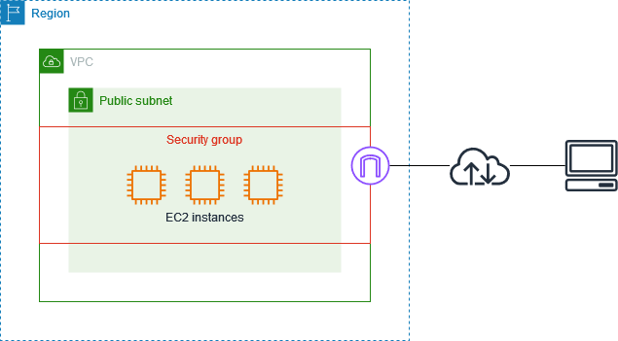
Security Group - Overview
The following diagram shows a VPC with a subnet, an internet gateway, and a security group.
The subnet contains EC2 instances.
The security group is associated with the instances.
The only traffic that reaches the instance is the traffic allowed by the security group rules.
For example, if the security group contains a rule that allows SSH traffic from your network, then you can connect to your instance from your computer using SSH. If the security group contains a rule that allows all traffic from the resources associated with it, then each instance can receive any traffic sent from the other instances.

Slide 48
Security Group - Overview
Security groups are stateful—if you send a request from your instance, the response traffic for that request is allowed to flow in regardless of inbound security group rules.
Also, responses to allowed inbound traffic are allowed to flow out, regardless of outbound rules.

Slide 49
Amazon EC2 key pairs
A key pair, consisting of a public key and a private key, is a set of security credentials that you use to prove your identity when connecting to an Amazon EC2 instance.
For Linux instances, the private key allows you to securely SSH into your instance.
For Windows instances, the private key is required to decrypt the administrator password, which you then use to connect to your instance.

Slide 50
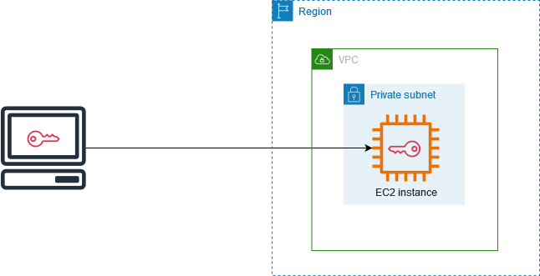
Amazon EC2 key pairs
Amazon EC2 stores the public key on your instance, and you store the private key, as shown in the following diagram.
It's important that you store your private key in a secure place because anyone who possesses your private key can connect to your instances that use the key pair.

Slide 51
Amazon EC2 key pairs
When you launch an instance, you can specify a key pair, so that you can connect to your instance using a method that requires a key pair.
Depending on how you manage your security, you can specify the same key pair for all your instances or you can specify different key pairs.

